Slide 1
Anomaly Detection in Microservices Cloud application: Granger Causality Test Course on Graph Neural Networks (Summer Term 22)
Prof. Dr. Holger Giese (holger.giese@hpi.uni-potsdam.de)
Christian Medeiros Adriano (christian.adriano@hpi.de) - “Chris”
Matthias Barkowski (matthias.barkowski@hpi.de )
Iqra Zafar (iqra.zafar@hpi.de)

Slide 2
Causal Inference(CI) Technique
The main objective of applying CI methods to performance diagnosis is to identify the causal graph with giving (anomalous) metrics, showing the anomaly propagation paths.
Problem statement: giving a set of k metrics M = {m1,m2,……mn} in a system with n services, once a service performance degradation is detected, how can we pinpoint the its root cause that first identifies the anomaly?

Slide 3
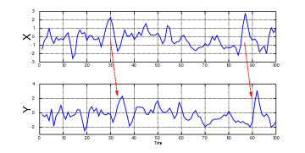
Overview of causal inference method: Granger Causality
Inferring the causal relationship between time-series based on temporal precedence
Used to determine whether or not one time series is useful for forecasting another.
This test uses the following null and alternative hypotheses:
Null Hypothesis (H₀): Time series x does not Granger-cause time series y
Alternative Hypothesis (H_{A}): Time series x Granger-causes time series y

Slide 4
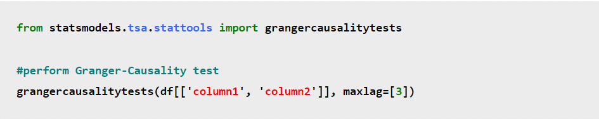
How to perform GC test
grangercausalitytests() function from the statsmodels
In statistics, p-values are commonly used in hypothesis testing
If the p-value of a hypothesis test is sufficiently low, we can reject the null hypothesis.
Specifically, when we conduct a hypothesis test, we must choose a significance level at the outset.
Common choices for significance levels are 0.01, 0.05, and 0.10.

Slide 5
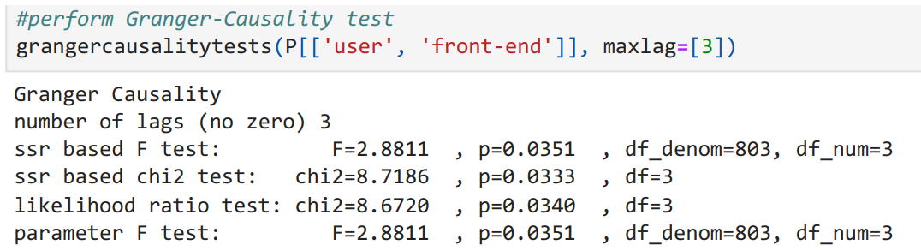

Granger Causality Test
A p-value indicates how believable the null hypothesis is, given the sample data.
the corresponding p-value is 0.03451.
Since the p-value is less than .05, we can reject the null hypothesis of the test and conclude that knowing the front-end service is useful for predicting the future number of users by CPU consumption metrics)

Slide 6
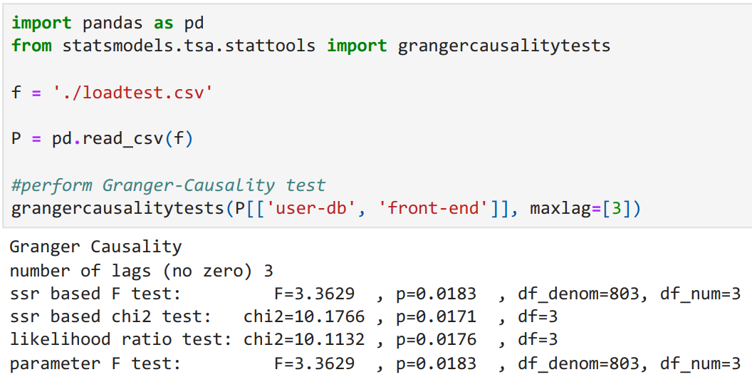

Granger Causality Test
the corresponding p-value is 0.0183
Since the p-value is less than .05, we can reject the null hypothesis of the test and conclude that knowing the front-end service is useful for predicting the future number of users-db by CPU consumption metrics)

Slide 7
END

